Slide 1
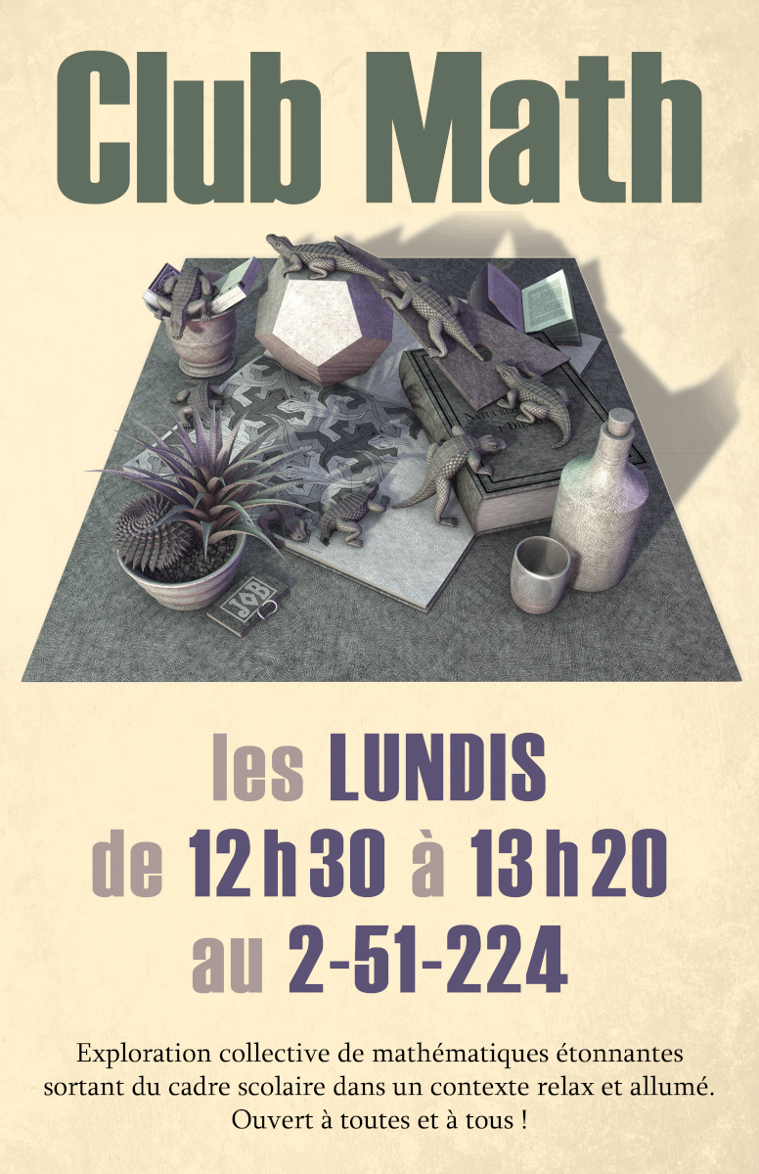
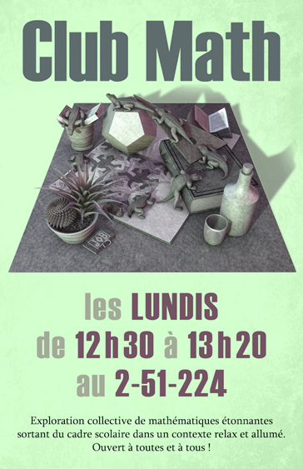

Slide 2
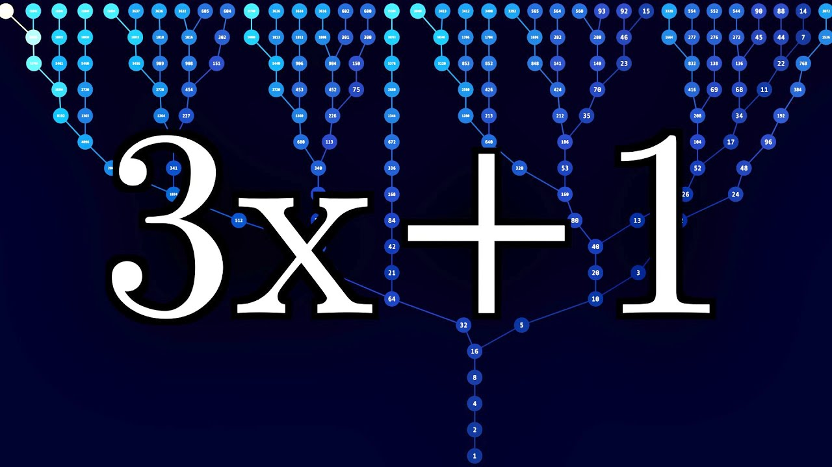

Slide 3
Vidéos
The Simplest Math Problem No One Can Solve (Veritasium)
https://www.youtube.com/watch?v=094y1Z2wpJg
La conjecture de Syracuse - Deux (deux ?) minutes pour... (El Jj)
https://www.youtube.com/watch?v=BP2G28694z8 (à 10:30)

Slide 4
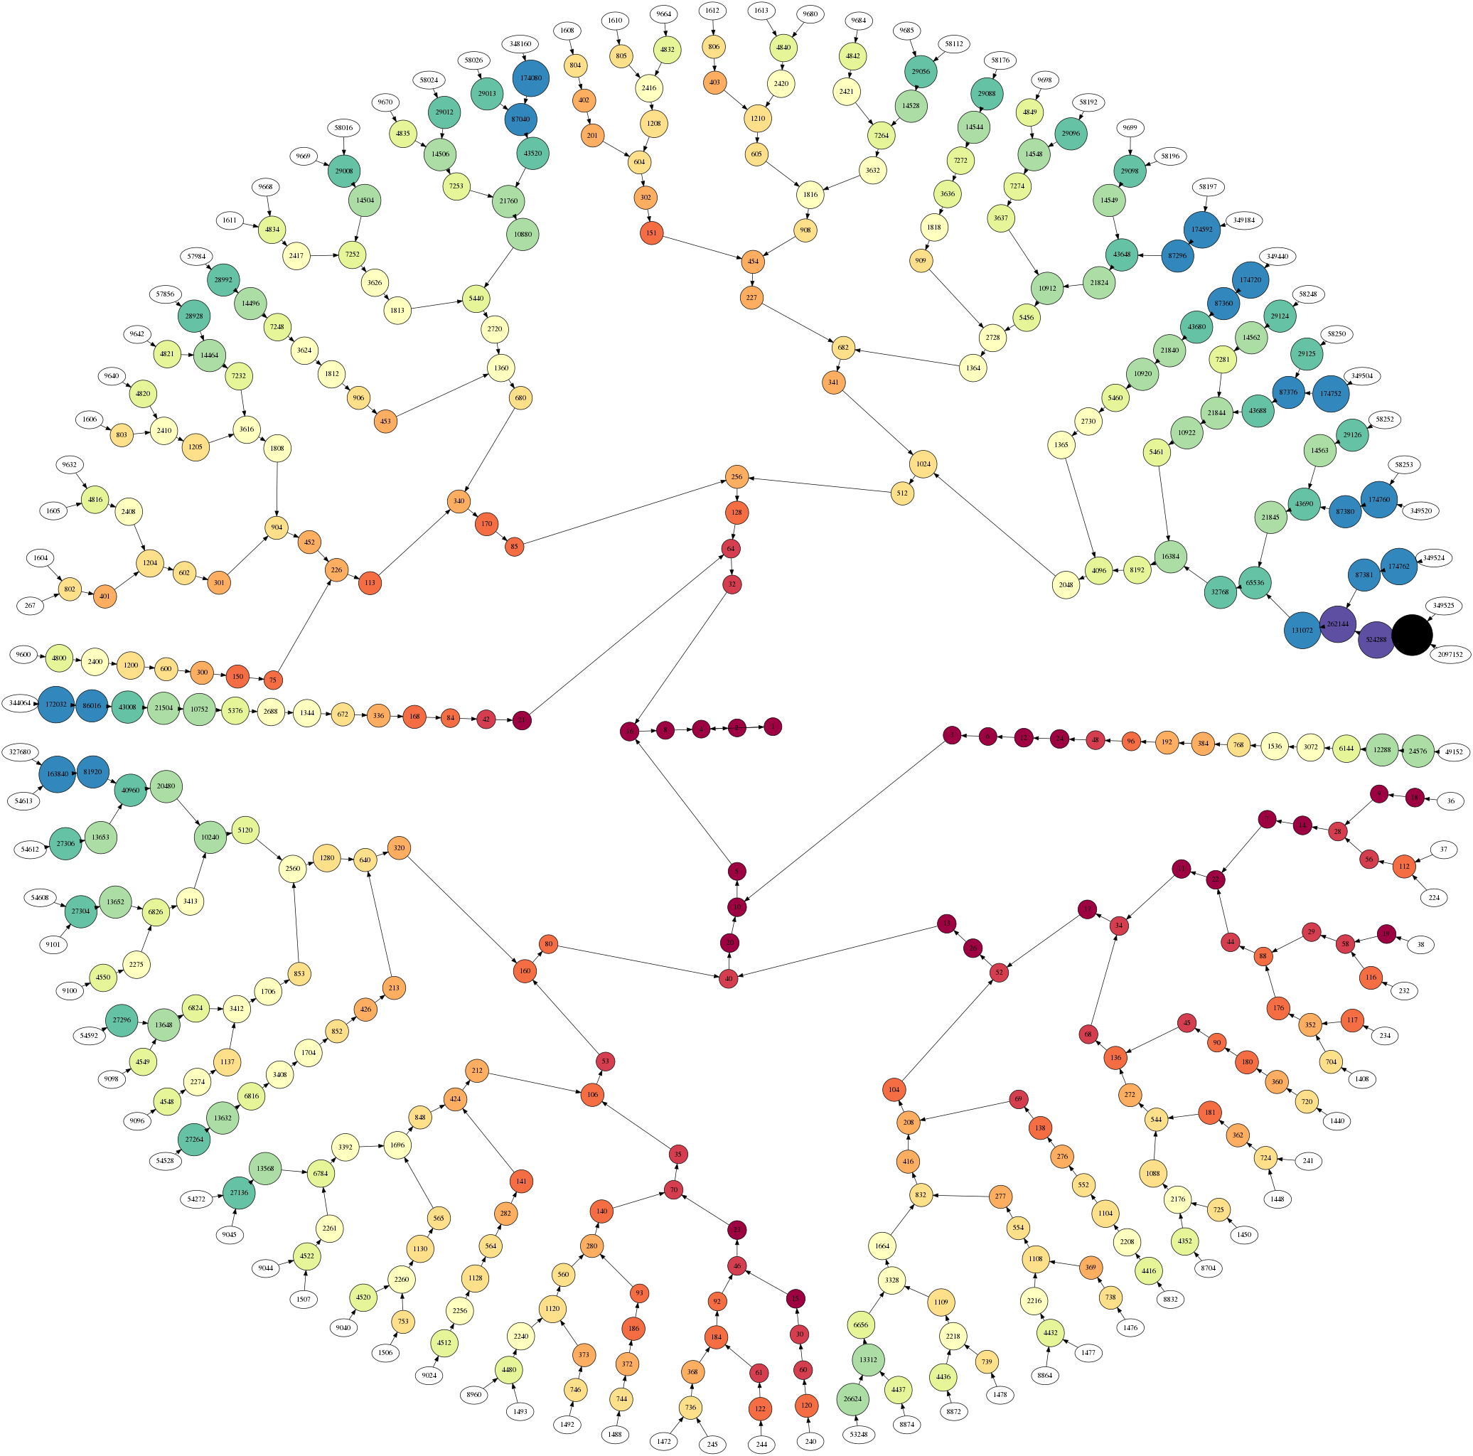
Visualisation
Collatz Conjecture in Color (Numberphile)
https://www.youtube.com/watch?v=LqKpkdRRLZw
Visualizing Collatz (Adrian M Wadley)
https://www.youtube.com/watch?v=RzQE2Q7lsT4

Slide 5
xkcd

Slide 6
Retour sur le jeu de la vie
Ryan Stringham
https://www.stringham.me/conway/
ConwayLife.com
https://conwaylife.com/

Slide 7
Saint-Valentin ♥

